Slide 1




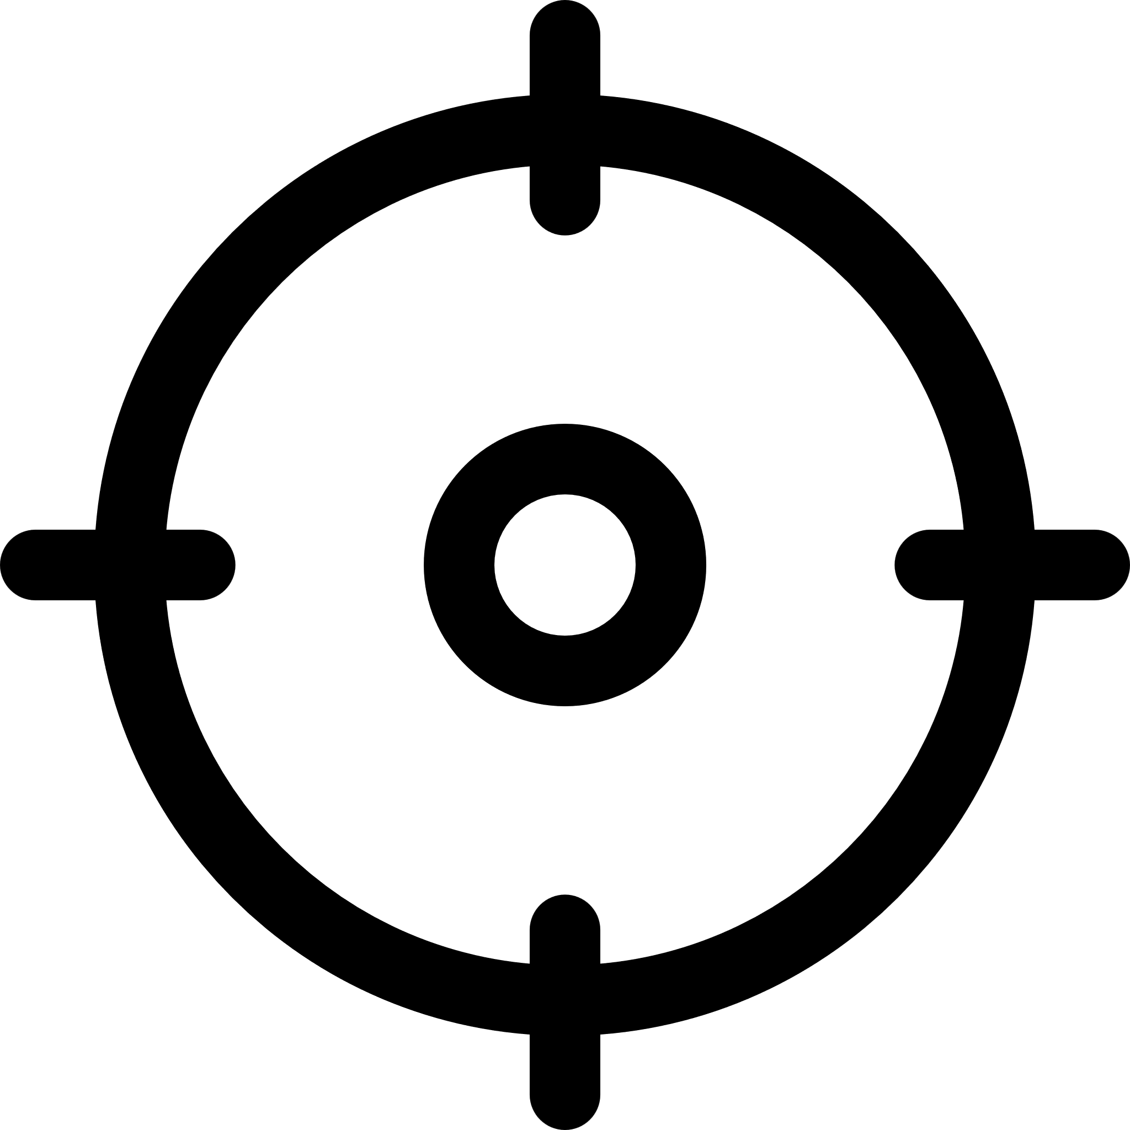






Defining an optimised fluconazole dosing strategy
in critically ill patients
Two-compartment model
177 patients
No consensus optimised fluconazole dosing regimen for critically ill patients
Standard dosing
Optimised dosing
Probability of target attainment
Day 1
71.98 %
95.40 %
Population pharmacokinetics modelling from 8 studies
Day 14
76.57 %
97.00 %
Conclusion: The proposed stratified fluconazole dosing strategy for critically ill patients based on continuous renal replacement therapy status and body weight results in high target attainment, making therapeutic drug monitoring obsolete.
Author: My Luong Vuong
@LuongMyVuong
Notes:
standardized vs optimised dosing
Efficacy
Toxicity

Slide 2
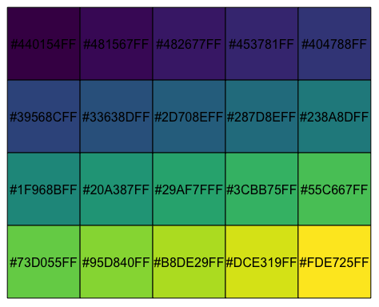
Conclusion: The proposed stratified fluconazole dosing strategy for critically ill patients based on continuous renal replacement therapy status and body weight results in high target attainment, making therapeutic drug monitoring obsolete.
Defining an optimised fluconazole dosing strategy
in critically ill patients
@LuongMyVuong
Two-compartment model
177 patients
No consensus optimised fluconazole dosing regimen for critically ill patients
Standard dosing
Optimised dosing
Probability of target attainment
Day 1
71.98 %
95.40 %
Population pharmacokinetics modelling from 8 studies
Day 14
76.57 %
97.00 %
Author: My Luong Vuong
Notes:
Font: Times, Arial, Courier or Symbol with a large enough font size
File type: preferred file types are TIFF, EPS, PDF or MS Office files.

Slide 3
Defining an optimised fluconazole dosing strategy
in critically ill patients
Two-compartment model
177 patients
No consensus optimised fluconazole dosing regimen for critically ill patients
Standard dosing
Optimised dosing
Probability of target attainment
Day 1
71.98 %
95.40 %
Population pharmacokinetics modelling from 8 studies
Day 14
76.57 %
97.00 %
Conclusion: The proposed stratified fluconazole dosing strategy for critically ill patients based on continuous renal replacement therapy status and body weight results in high target attainment, making therapeutic drug monitoring obsolete.
Author: My Luong Vuong
@LuongMyVuong
Notes:
Font: Times, Arial, Courier or Symbol with a large enough font size
File type: preferred file types are TIFF, EPS, PDF or MS Office files.

